Slide 1
Association Rules Mining
By Dr. Ali Saeed

Slide 2
A – Priory Algorithm
It is a popular association rules mining algorithm
It based on the concept of Min_Support and Min_Confidence
It is also known as Market Basket Analysis
It can be use in all online / offline stores and social media websites
Example is available on the next slide

Slide 3
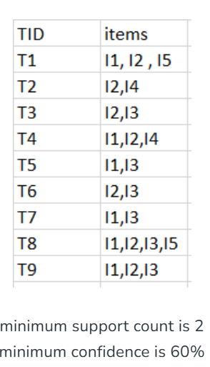
Let Assume the following dataset:
Here the rule is we will only consider the rule
Is strong is it has Min Support Count 2 and Min
Confidence 60%.
Otherwise, we reject the rules

Slide 4
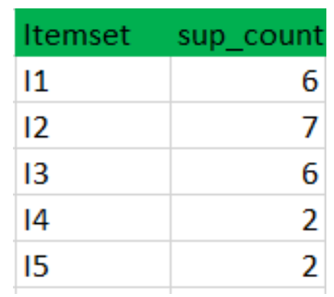
Items with minimum support count 2:
Here we count how many times an item appears We
will only pick that items that has support count is 2

Slide 5
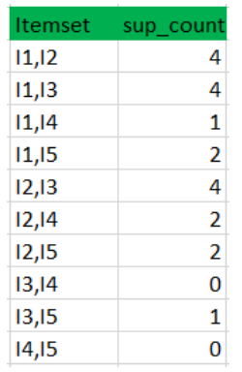
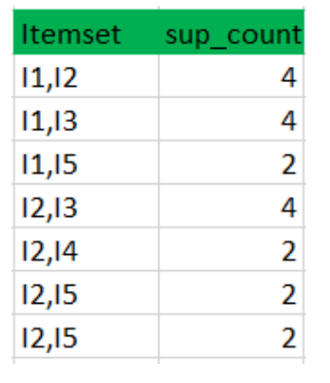
Two Items: Count with minimum support count 2
Here we count how many times an item appears We will only pick that items that has support count is 2

Slide 6
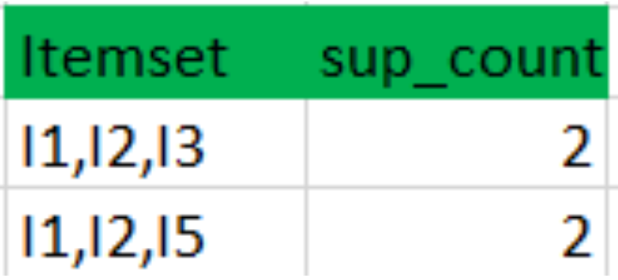
Three Items: Count with minimum support count 2
For 3 item set perform the same operation:
Here we count how many times an item appears We
will only pick that items that has support count is 2

Slide 7

Confidence calculating formula

Slide 8
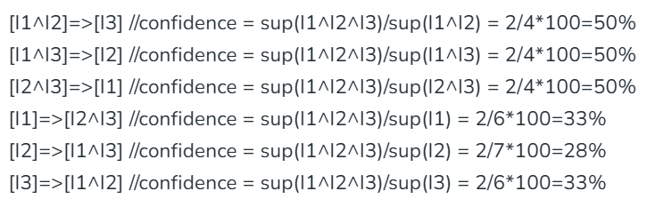
Some Confidence calculation examples
We will only consider the rules strong if it has confidence more then 60%

Slide 9
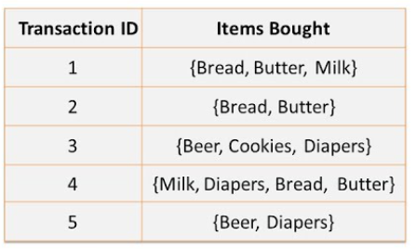
Class Exercise of A-Priory Algorithm

Slide 10
Thanks

